Slide 1
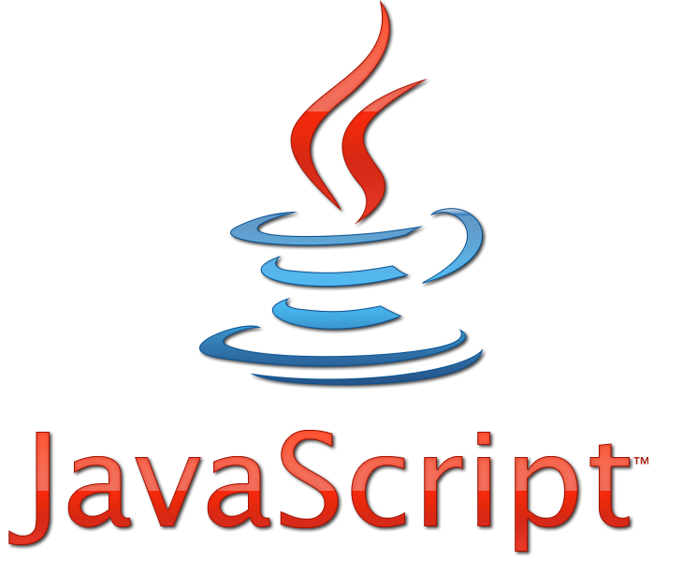
JavaScript
Lesson 1

Slide 2
What Is JavaScript?
JavaScript is a Scripting Language
JavaScript is programming code that can be inserted into HTML pages.
All modern HTML pages are using JavaScript.
JavaScript code can be executed by all modern web browsers.

Slide 3
JavaScript in <head> or <body>
JavaScripts can be put in the <body> and in the <head> section of an HTML page.
<script>
alert("My First JavaScript");
</script>
Scripts can also be placed in external files.
<!DOCTYPE html>
<html>
<body>
<script src="myScript.js"></script>
</body>
</html>

Slide 4
Manage Html with JavaScript
JavaScript is typically used to manipulate HTML elements.
<!DOCTYPE html>
<html>
<body>
<h1>My First Web Page</h1>
<p id="demo">My First Paragraph</p>
<script>
document.getElementById("demo").innerHTML="My First JavaScript";
document.write("<p>THIS IS NEW PARAGRAPH</p>");
</script>
</body>
</html>

Slide 5
JavaScript Comments
JavaScript comments can be used to make the code more readable.
<!DOCTYPE html>
<html>
<body>
<h1 id="page_title"></h1>
<p>Single line comments start with //.</p>
<script>
// Write to a heading:
document.getElementById("page_title").innerHTML="Welcome";
</script>
</body>
</html>

Slide 6
JavaScript Variables
JavaScript variables are "containers" for storing information:
Variable names must begin with a letter
Variable names are case sensitive (x and X are different variables)
<script>
var x=5;
var y=6;
var z=x+y;
alert(z);
</script>
<p id= "demo" > It will be changed</p>
<script>
var subject= "Javascript";
document.getElementById("demo").innerHTML= subject;
</script>
<script>
var z= "CSS";
z= "Javascript ";
alert(z);
</script>

Slide 7
JavaScript Data Types
String, Number, Boolean, Array, Object, Null, Undefined.
<script>
//String example
var x= "hello" ;
</script>
<script>
//Number example
var x=75;
</script>
<script>
//Boolean example
var x= true;
var y= false ;
</script>
<script>
//Array example
var x=new Array("Html", "Css", "Script");
var y=["Html", "Css", "Script"];
var z=new Array();
z[0]="Html";
z[1]="Css";
z[2]="Script";
</script>

Slide 8
JavaScript Data Types
String, Number, Boolean, Array, Object, Null, Undefined.
<script>
//Object example
var person={name:"John", lastname:"Lennon", id:5566};
//Get object properties
name=person.name;
name=person["name"];
</script>
<script>
//Null example
var x=null;
</script>
<script>
//Undefined example
var x;
</script>

Slide 9
JavaScript Function Syntax
A function is a block of code that will be executed when "someone" calls it.
<!DOCTYPE html>
<html>
<head>
<script>
function myFunction()
{
alert("Hello World!");
}
</script>
</head>
<body>
<button onclick="myFunction()">Try it</button>
</body>
</html>

Slide 10
JavaScript Functions
<script>
function simple(x)
{
alert(x);
}
simple("welcome");
</script>
<script>
function sum(x,y)
{
var z=x+y;
alert(z);
}
sum (5,6);
</script>
<script>
function sum(x,y)
{
var z=x+y;
return z;
}
var result= sum(5,6);
alert(result);
</script>

Slide 11
Task 1:
Ստեղծել կոճակ creator անունով, որի վրա սեղմելիս էջում ստեղծվի div էլեմենտ և իր մեջ պարունակի նկար:

Slide 12
Task 2:
Գրել ֆունկցիա,որը կհաշվի և կվերադարձնի որպես պարամետր ստացած 3 թվերի միջին թվաբանականը:

